Slide 1
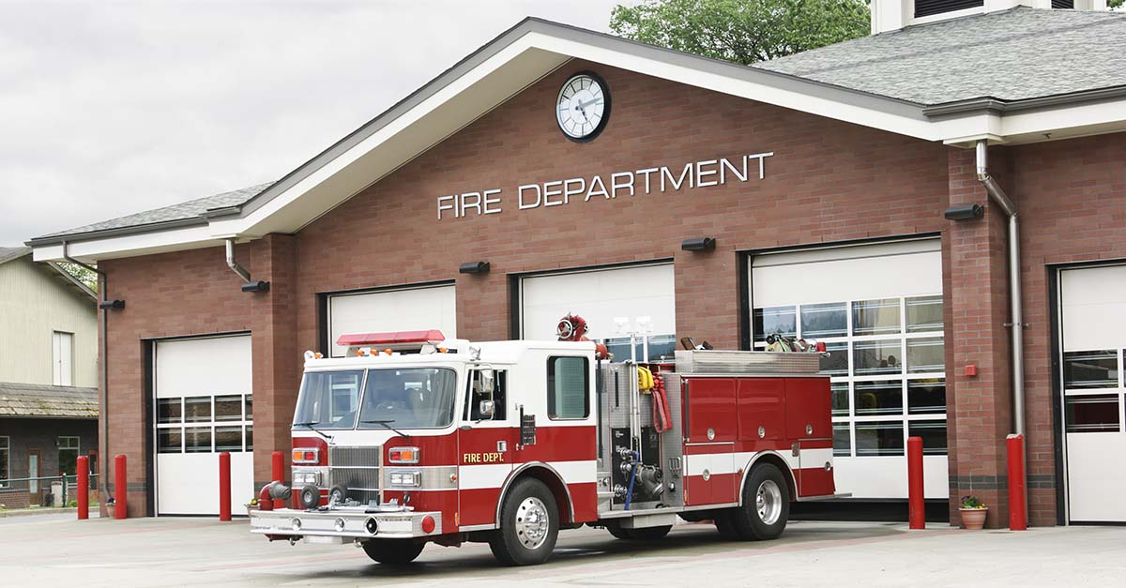
CALL LOG ANALYSIS IN SAN FRANCISCO
GUIDED BY BY
DR. JONGWOOK WOO SHANMATHI ARUL MURUGAN
ASHWIN.P.KARTHIK
KAUSHIK SRIDHARAN

Slide 2

Contents
Introduction
Project Scope
Data Set
Hardware Specifications
Workflow
Queries
Data Visualizations
Summary
Limitations

Slide 3
Introduction
San Francisco Fire Department (SFFD)
The mission of the Fire Department is to protect the lives and property of the people of San Francisco from fires, natural disasters, and hazardous materials incidents; to save lives by providing emergency medical services; to prevent fires through prevention and education programs; and to provide a work environment that values health, wellness and cultural diversity and is free of harassment and discrimination The San Francisco Fire Department was established in 1866 and serves an estimated population of 1.4 Billion people residing in San Francisco
In this project, we focus on analyzing the several incidents that occurred between the year 2000 to 2004, its criticality, priority given to each incident, the units that were involved in resolving each cases, how the incidents have varied over the years in different parts of San Francisco

Slide 4
Project Scope
Analysis on 4 years San Francisco’s Fire Department dataset
The dataset obtained was analyzed using Oracle Cloud and HIVEQL
Data in HDFS was accessed using WINSCP
Visualization of the data analysis is done using Tableau

Slide 5




Work Flow
Analysis
BerryCloud
Data Logs
Reports Generated

Slide 6
Data Set
Dataset link : https://data.sfgov.org/Public-Safety/Fire-Department-Calls-for-Service/nuek-vuh3
Dataset contains about 4.51Million rows and 34 columns
Dataset mainly comprises of:
Call Id
Incident types
Location details
Format: CSV
Size: 1.5 GB

Slide 7
Hardware Specification
Number Of Head Nodes = 2 | CPU = 8 Cores
Number Of Worker Nodes = 4 |CPU = 32 Cores
Processor - 2.4 GHz Intel Xeon® E5-2673 v3
Ram – 24 GB
Disks – 16
Local SSD – 400 GB
Cluster – Hadoop Azure HD Insights

Slide 8
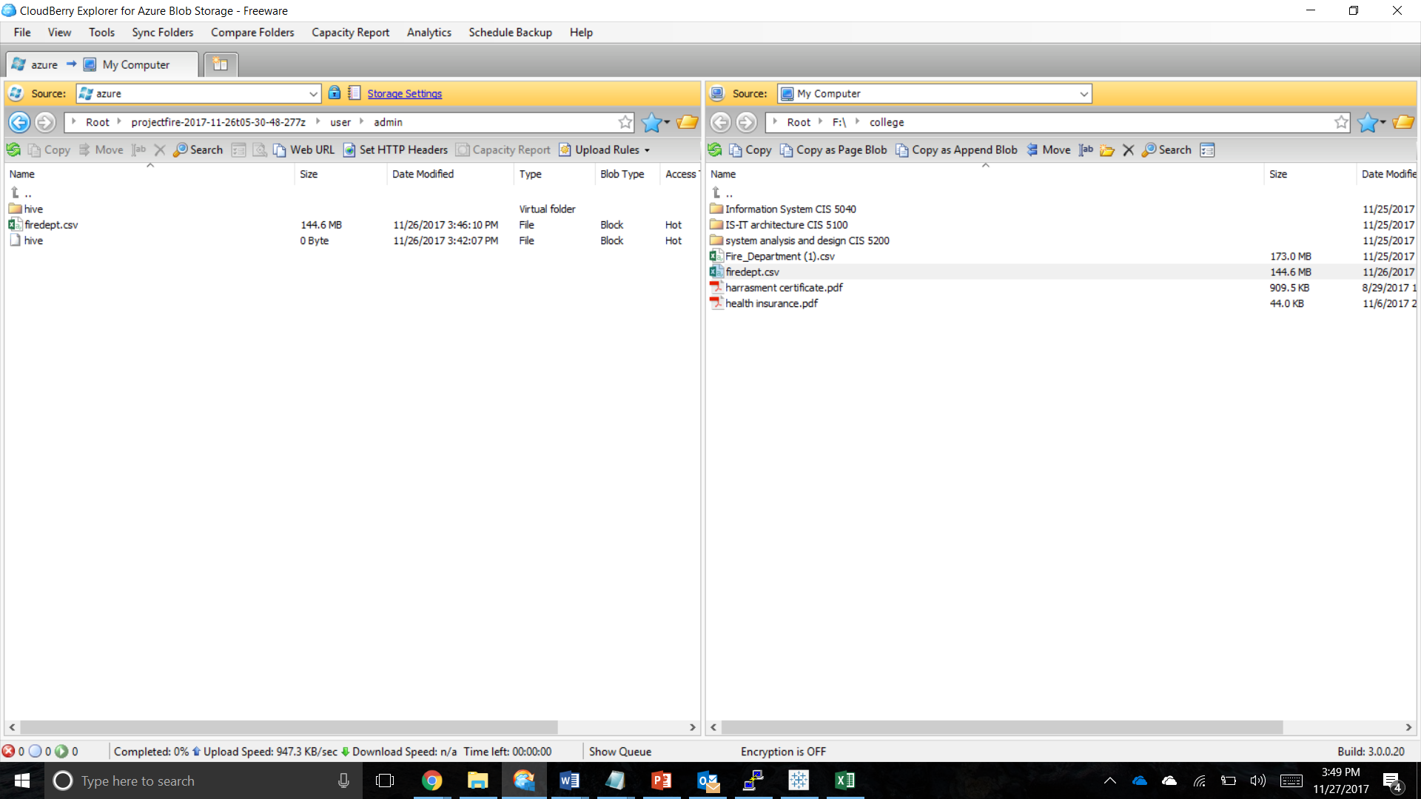
Cloudberry Explorer For Azure

Slide 9
Queries Used
DROP TABLE firedept;
CREATE EXTERNAL TABLE IF NOT EXISTS
firedept(Call_Number BIGINT,Incident_Number INT,Call_Type STRING,Call_Date DATE,Day INT,Month INT,Year INT,Call_Final_Disposition STRING,Address STRING,Zipcode BIGINT,Box INT,Priority INT,ALS_Unit STRING,Number_of_Alarms INT,Unit_Type STRING,Neighborhood STRING,Lattitude DOUBLE,Longitude DOUBLE)
ROW FORMAT DELIMITED FIELDS TERMINATED BY '|'
tblproperties ("skip.header.line.count"="1");
LOAD DATA INPATH '/user/shannu94/firedept/firedept.csv'
OVERWRITE INTO TABLE firedept;

Slide 10
Queries Used
CREATE TABLE qn2
ROW FORMAT DELIMITED FIELDS TERMINATED BY '|'
STORED AS TEXTFILE LOCATION './Output1/'
AS
SELECT count(Incident_Number),Zipcode FROM firedept WHERE Incident_Number IS NOT NULL group by Zipcode;
SELECT * FROM qn2;

Slide 11
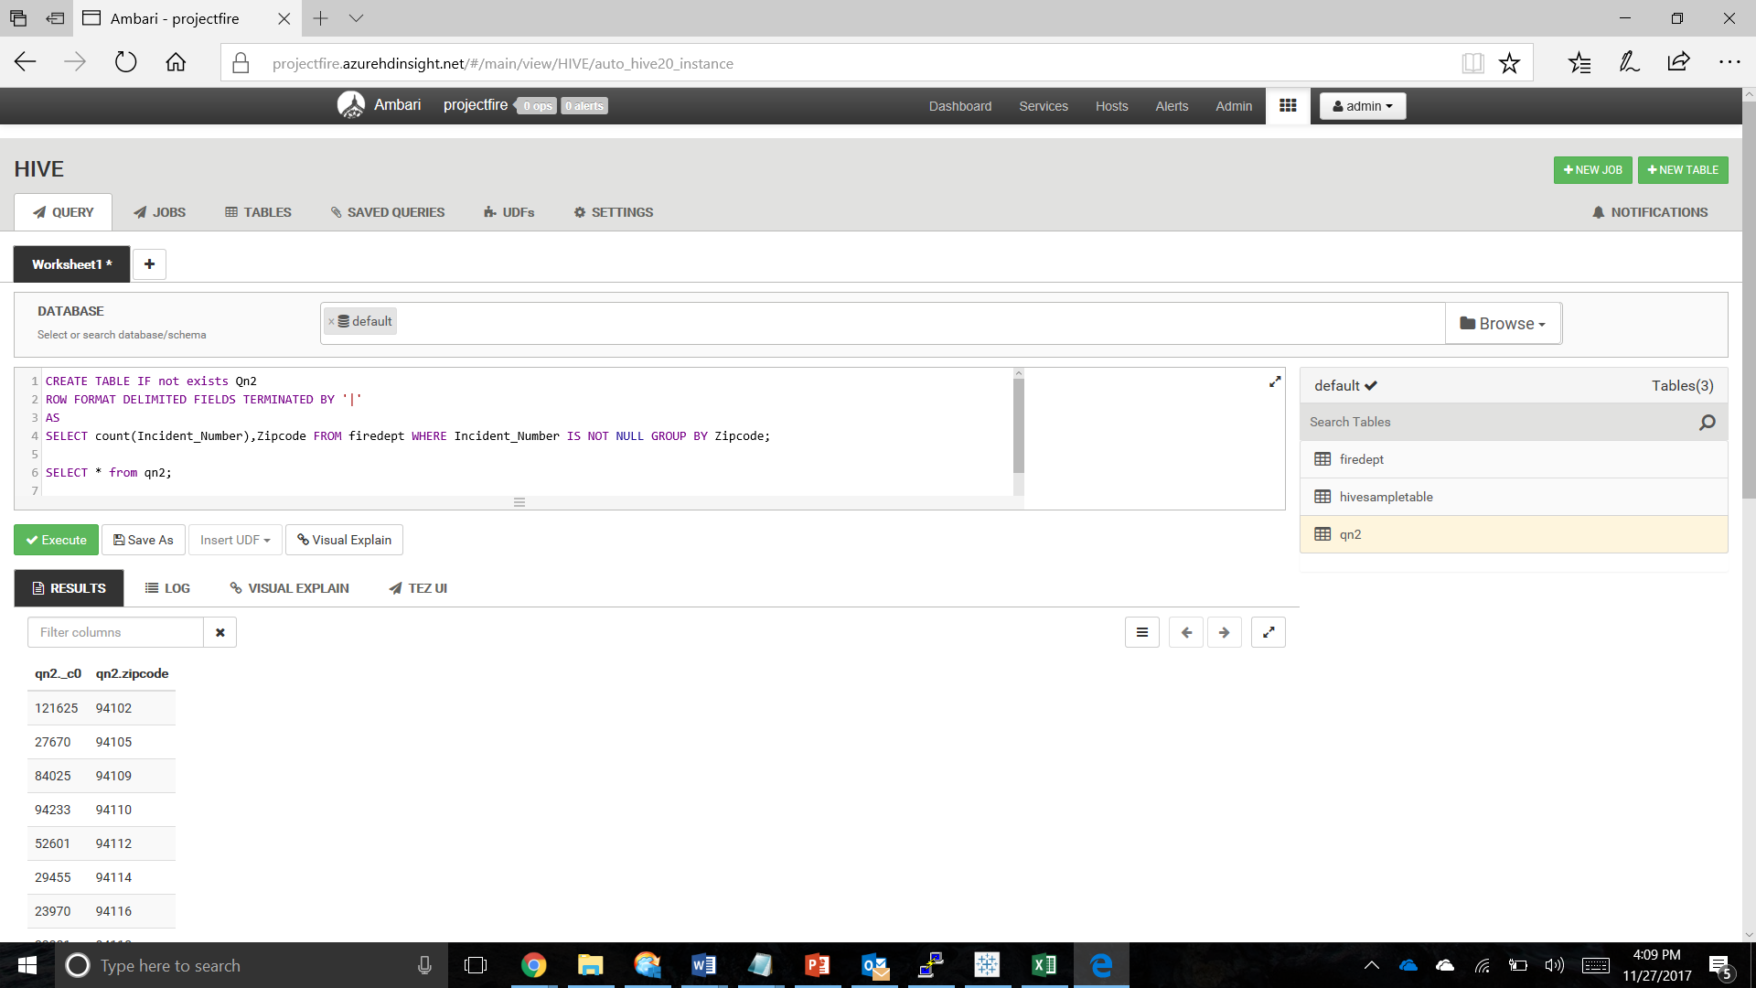
Queries Executed

Slide 12
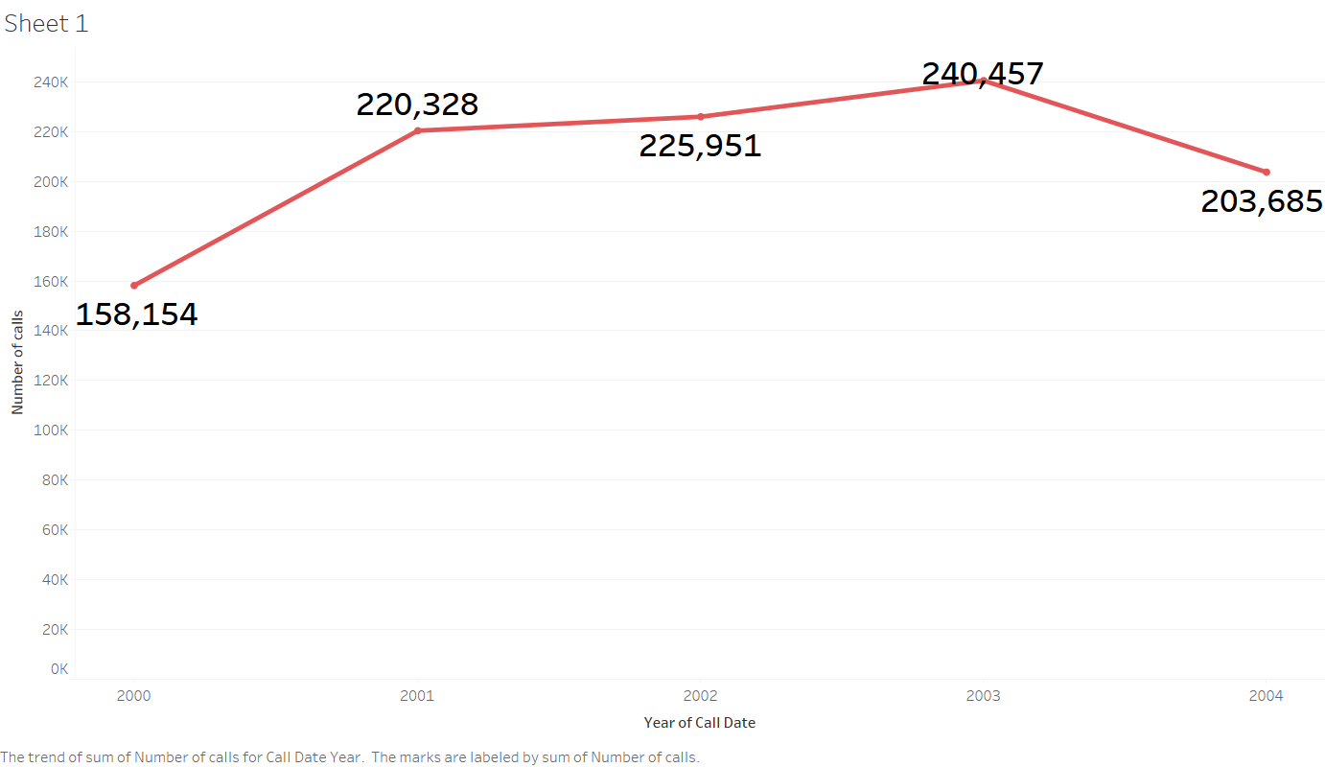
Calls received by the fire department on a specific date

Slide 13
Calls received by the fire department on a specific date
Maximum Number of calls:
Year 2003
Year 2001
From the Line Chart, we see that the Fire Department of San Francisco has received about 240,457 calls in the year 2003 and 220,328 calls in the year 2001.

Slide 14
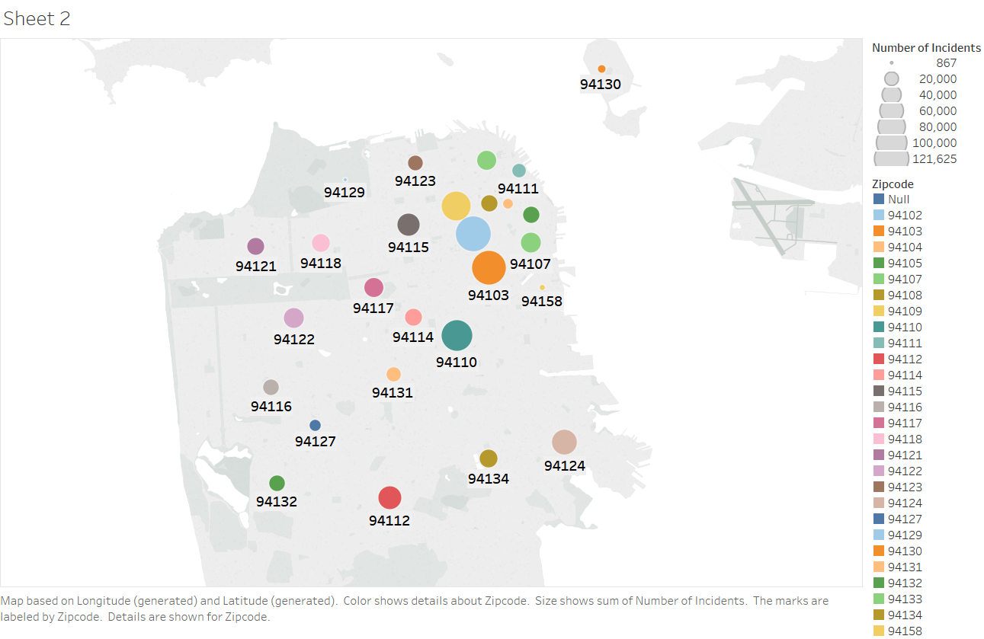
Number of incidents that happened in a particular zip code

Slide 15
Number of incidents that happened in a particular zip code
Zip codes with majority Incidents:
94102
94103
The analysis shows that the majority of incidents occurred in two neighboring zip codes accounting to 121,625 incidents in 94102 and 113,947 in 94103.

Slide 16
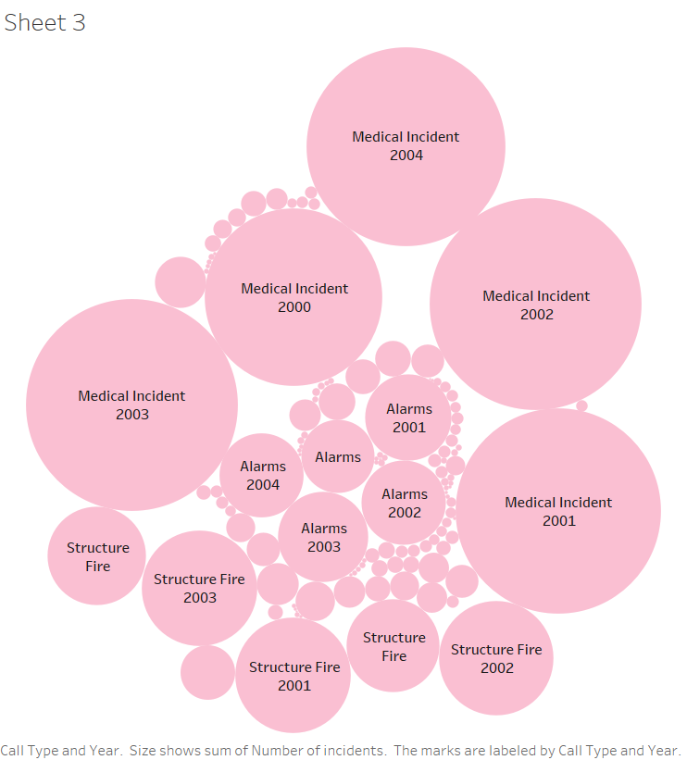
The trend of each incident over the years

Slide 17
The trend of each incident over the years
Leading reported Incidents:
Medical Incident
Structure Fire
Alarms
The Packed Bubbles chart clearly states that from the year 2000 to 2004 the fire department received calls majorly for three issues, Medical Incidents leading the list.

Slide 18
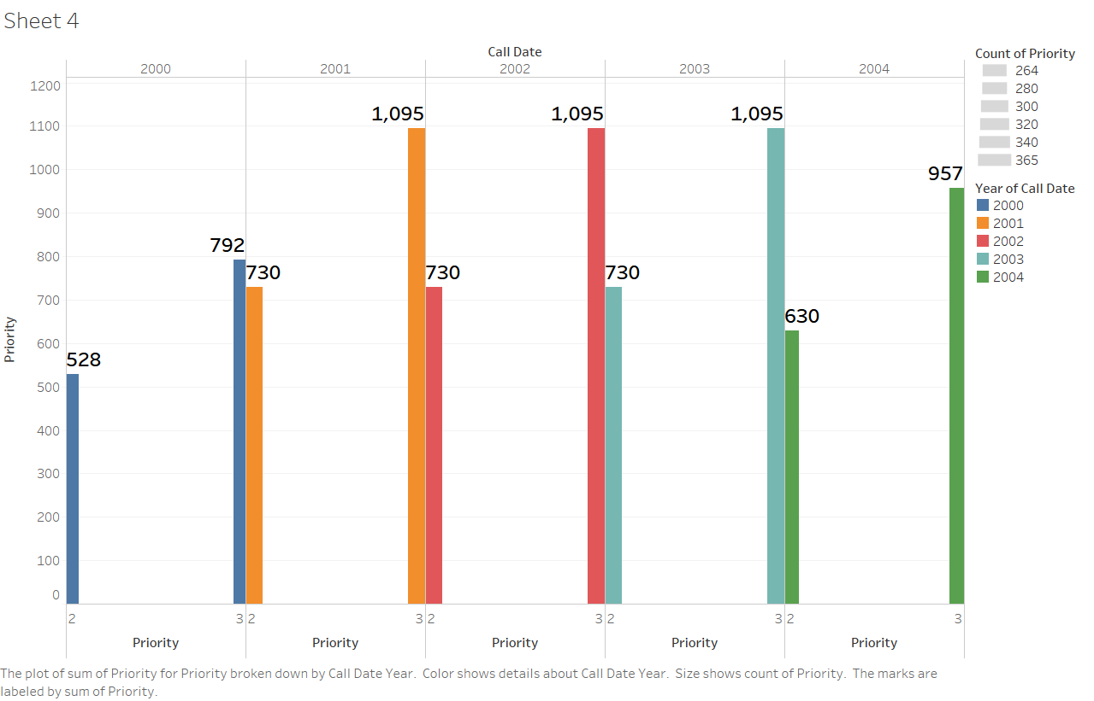
Number of high priority and low priority calls received per day

Slide 19
Number of high priority and low priority calls received per day
3 – High Priority
2 – Low Priority
The Fire Department categorized each incidents into two different priorities – High and Low. We analyzed that three consecutive years 2001, 2002 and 2003 has received the most high priority calls.

Slide 20
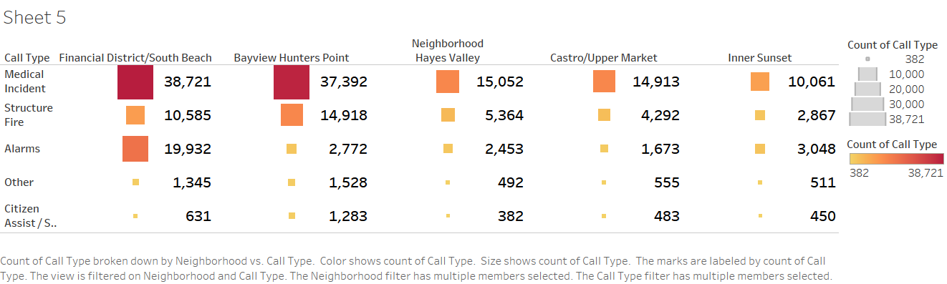
Intensity of each incident over the geospatial locations in San Francisco

Slide 21
Intensity of each incident over the geospatial locations in San Francisco
Among the various areas/cities in San Francisco, with the help of Heat Map the five major areas to have reported most incidents are Financial District/South Beach, Bayview Hunters Point, Neighborhood Hayes Valley, Castro/Upper Market and Inner Sunset.

Slide 22
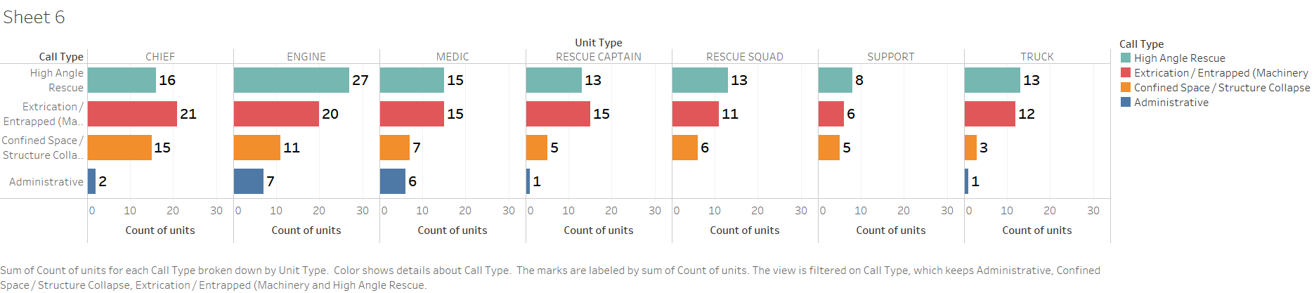
Number of unit types dispatched for each incident during the year 2000 to 2004

Slide 23
Number of unit types dispatched for each incident during the year 2000 to 2004
The analysis is on the Unit Types that are sent by the Fire department for each Incident (filtering the least 5). It can be inferred that the Administrative call type requires the least dispatch unit compared to others.

Slide 24
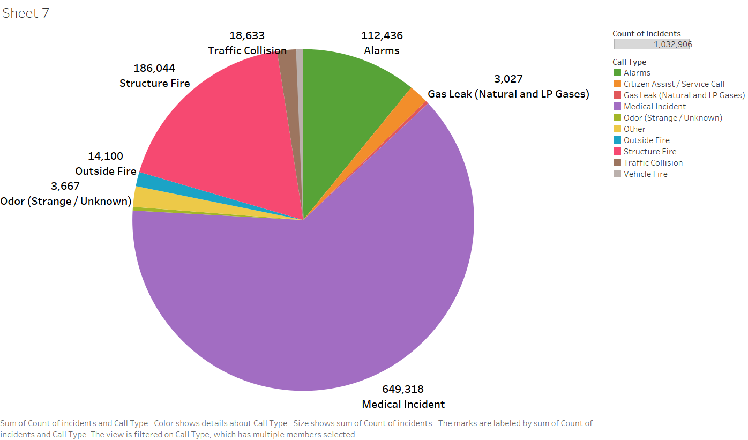
The top 10 incidents that happened over the years

Slide 25
The top 10 incidents that happened over the years
Traffic Collision
Outside Fire
Vehicle Fire
Odor (Strange/Unknown)
Gas Leak (Natural and LP Gases)
Medical Incident
Structure Fire
Alarms
Other
Citizen Assist / Service Call

Slide 26
Summary
Most calls were received in the YEAR 2003
Most incident prone areas are of zipcodes 94102, 94103 and 94109
Medical Incident was observed to see highest no of count
High priority calls were listed during 2004 and low priority calls were registered in 2001
Medical Incident is the highest intensity over the geo spatial location
Administrative incident had the least requirement for dispatch units from San Francisco Fire Department

Slide 27
LIMITATIONS
From the available dataset, holding few parameters, we were able to analyze only the type of incident over a span of 4 years.
Had the data been more detailed i.e. holding information regarding the cause of the incident, it would have been possible to analyze and infer the major reasons for the incident and provided a solution
Certain incidents could be done as crimes too, had the data about incident caused by crimes be given, we could have analyzed the crimes that cause the incidents
Had the data about damage been specified , we would have been able to analyze each incident in depth.

Slide 28

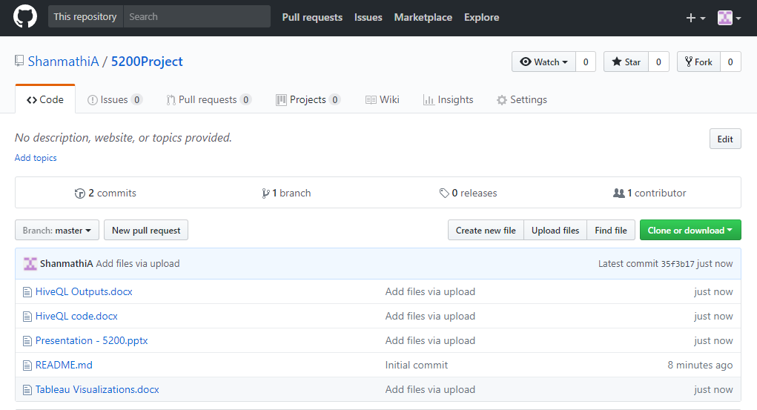
Github https://github.com/ShanmathiA/5200Project

Slide 29
Thank you!

